Slide 1


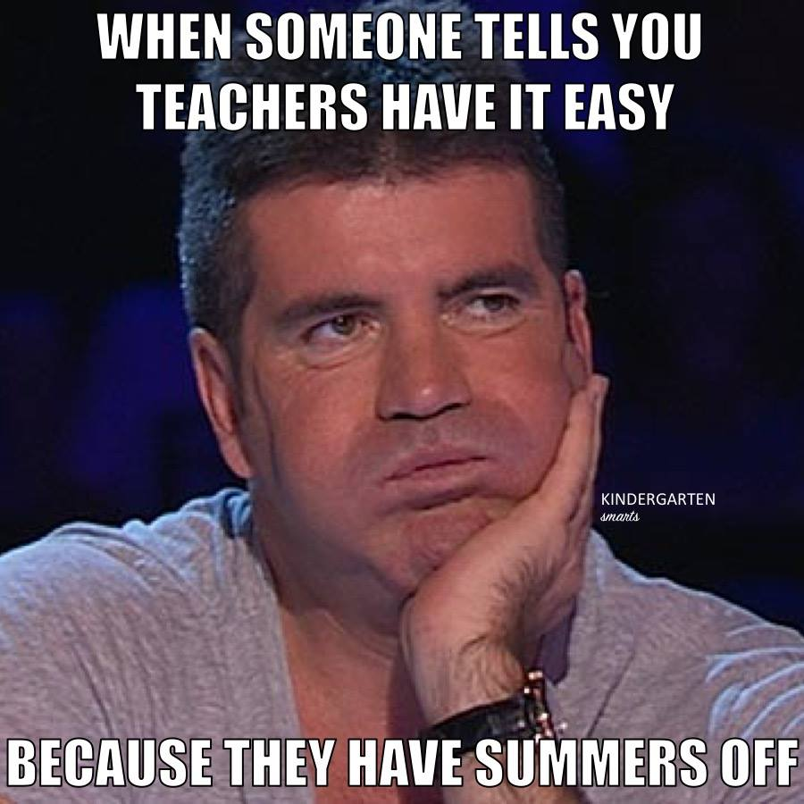










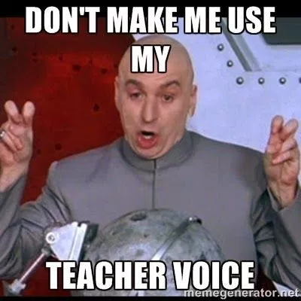

Slide 2



Coding With Students Made Easy….With
@TeachCode | #TeachCode | @pbcsdTechConf | #pbcsdTechConf

Slide 3

@TeachCode | #TeachCode | @pbcsdTechConf | #pbcsdTechConf

Slide 4
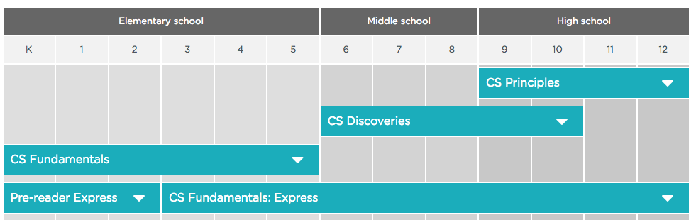
Where to start?
https://studio.code.org/courses
@TeachCode | #TeachCode | @pbcsdTechConf | #pbcsdTechConf

Slide 5
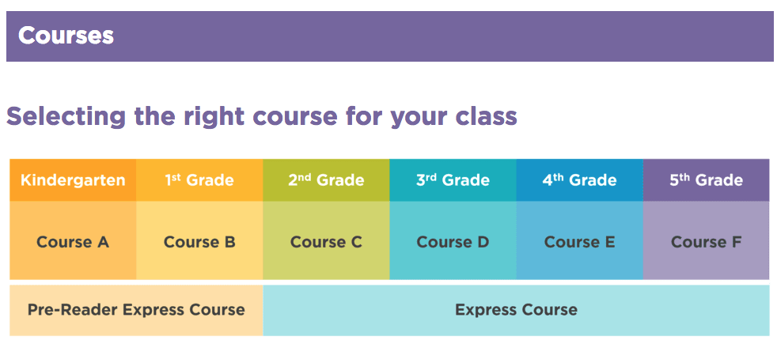
Elementary Students
https://code.org/educate/curriculum/elementary-school
@TeachCode | #TeachCode | @pbcsdTechConf | #pbcsdTechConf

Slide 6
Middle School Students
CS Discoveries https://code.org/educate/csd
Designed for Grades 6-10
6 Unit Course designed for a full year.
Or 1-3 Semester 1 and 4-6 Semester 2
Deadline to apply for training is March 30th. Free
Science Curriculum https://code.org/curriculum/science
4 Module Course Connecting Science to Computer Science
Algebra Curriculum https://code.org/educate/algebra
10 Hour Course Connecting Math to Computer Science
@TeachCode | #TeachCode | @pbcsdTechConf | #pbcsdTechConf

Slide 7
High School Students
CS Discoveries https://code.org/educate/csd
Designed for Grades 6-10
6 Unit Course designed for a full year.
Or 1-3 Semester 1 and 4-6 Semester 2
Deadline to apply for training is March 30th. Free
CS Principles https://code.org/educate/csp
Aligned with Computer Science AP Test
5 Units designed for a full year
AP Test Prep
Deadline to apply for training is March 30th. Free
@TeachCode | #TeachCode | @pbcsdTechConf | #pbcsdTechConf

Slide 8
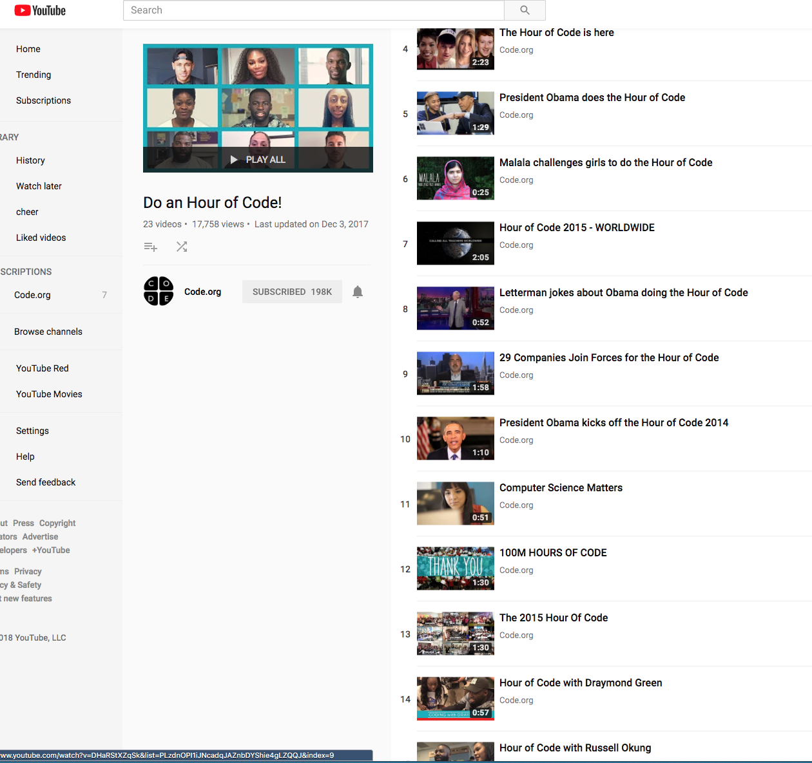
Hour of Code
Have a coding Club
Go to training with Code.org
Host an Hour of Code (2nd week in Dec)
code.org/learn
Videos to Inspire
https://www.youtube.com/channel/UCJyEBMU1xVP2be1-AoGS1BA
@TeachCode | #TeachCode | @pbcsdTechConf | #pbcsdTechConf

Slide 9
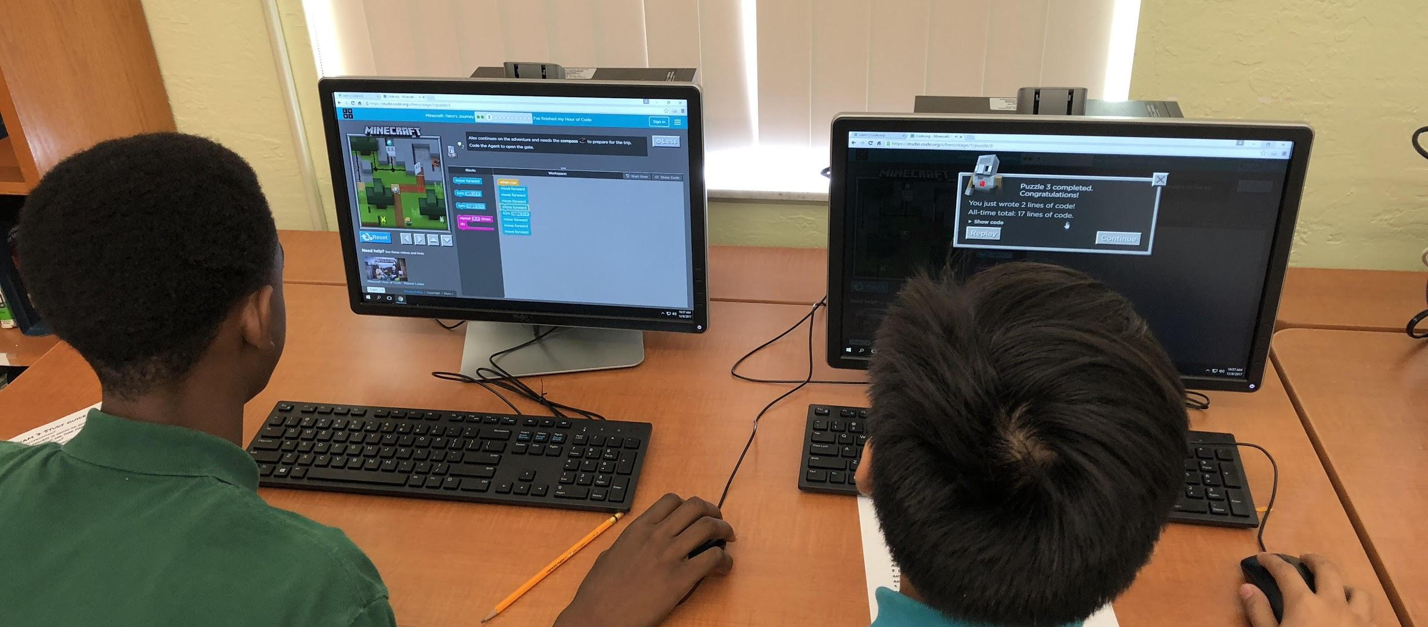
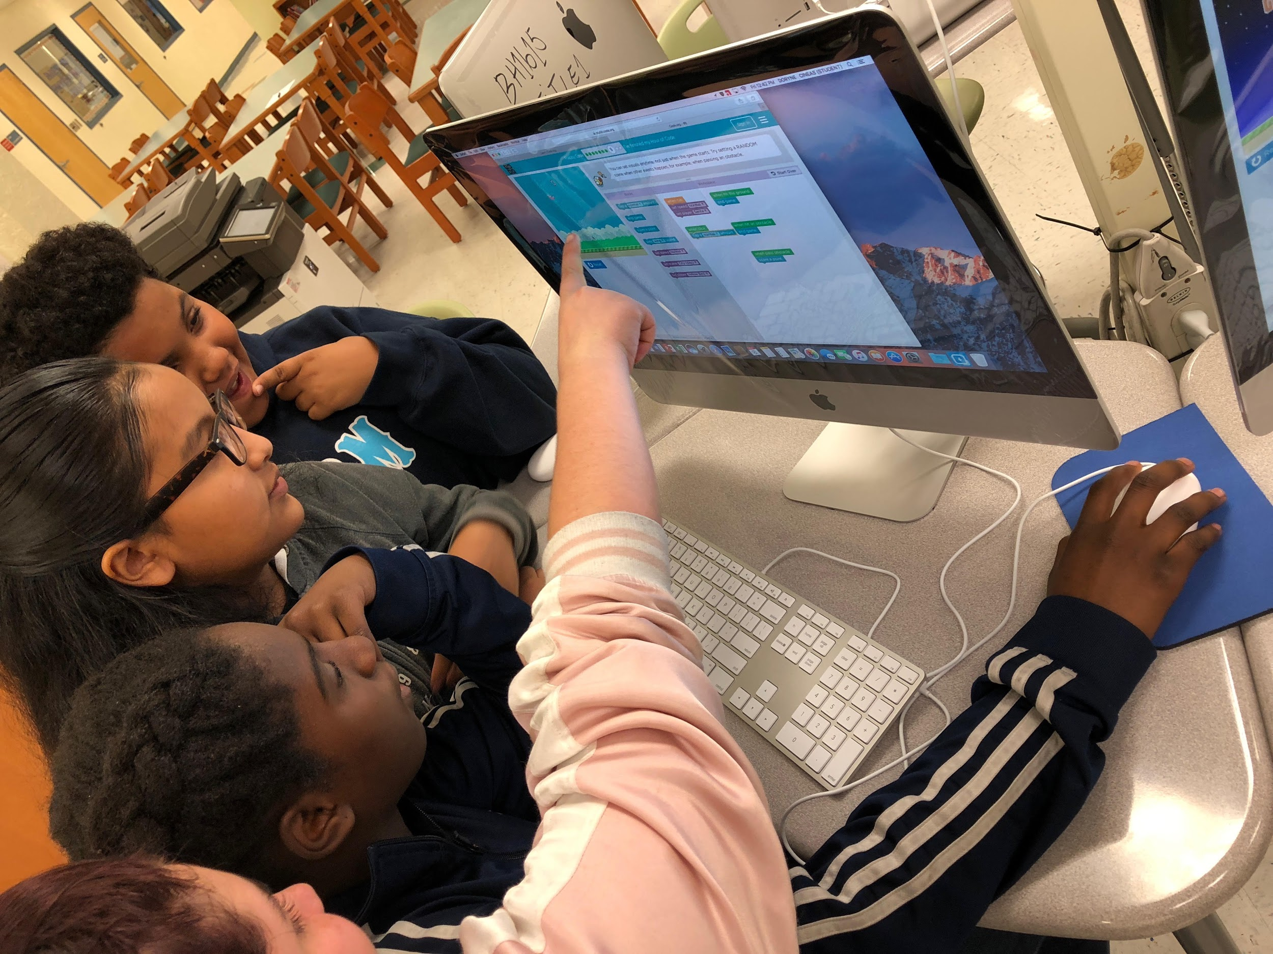
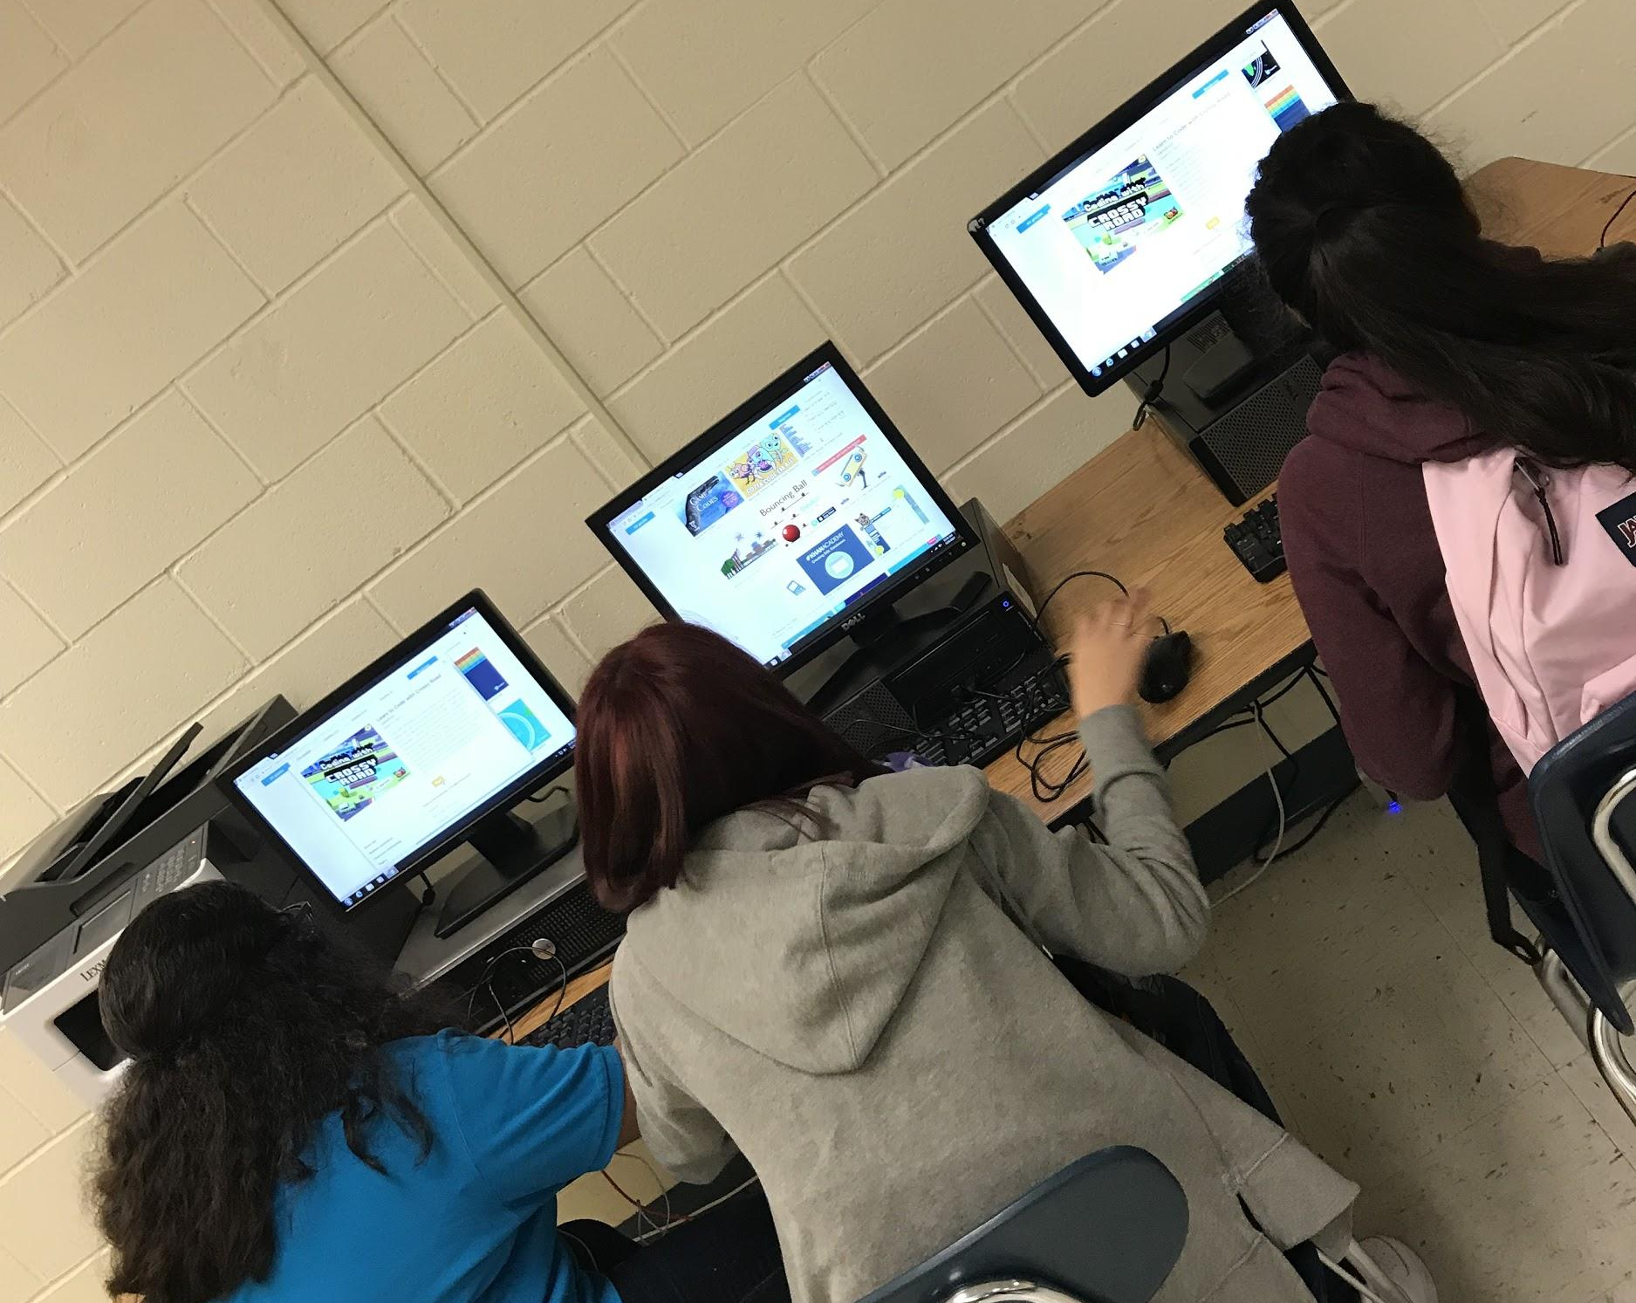
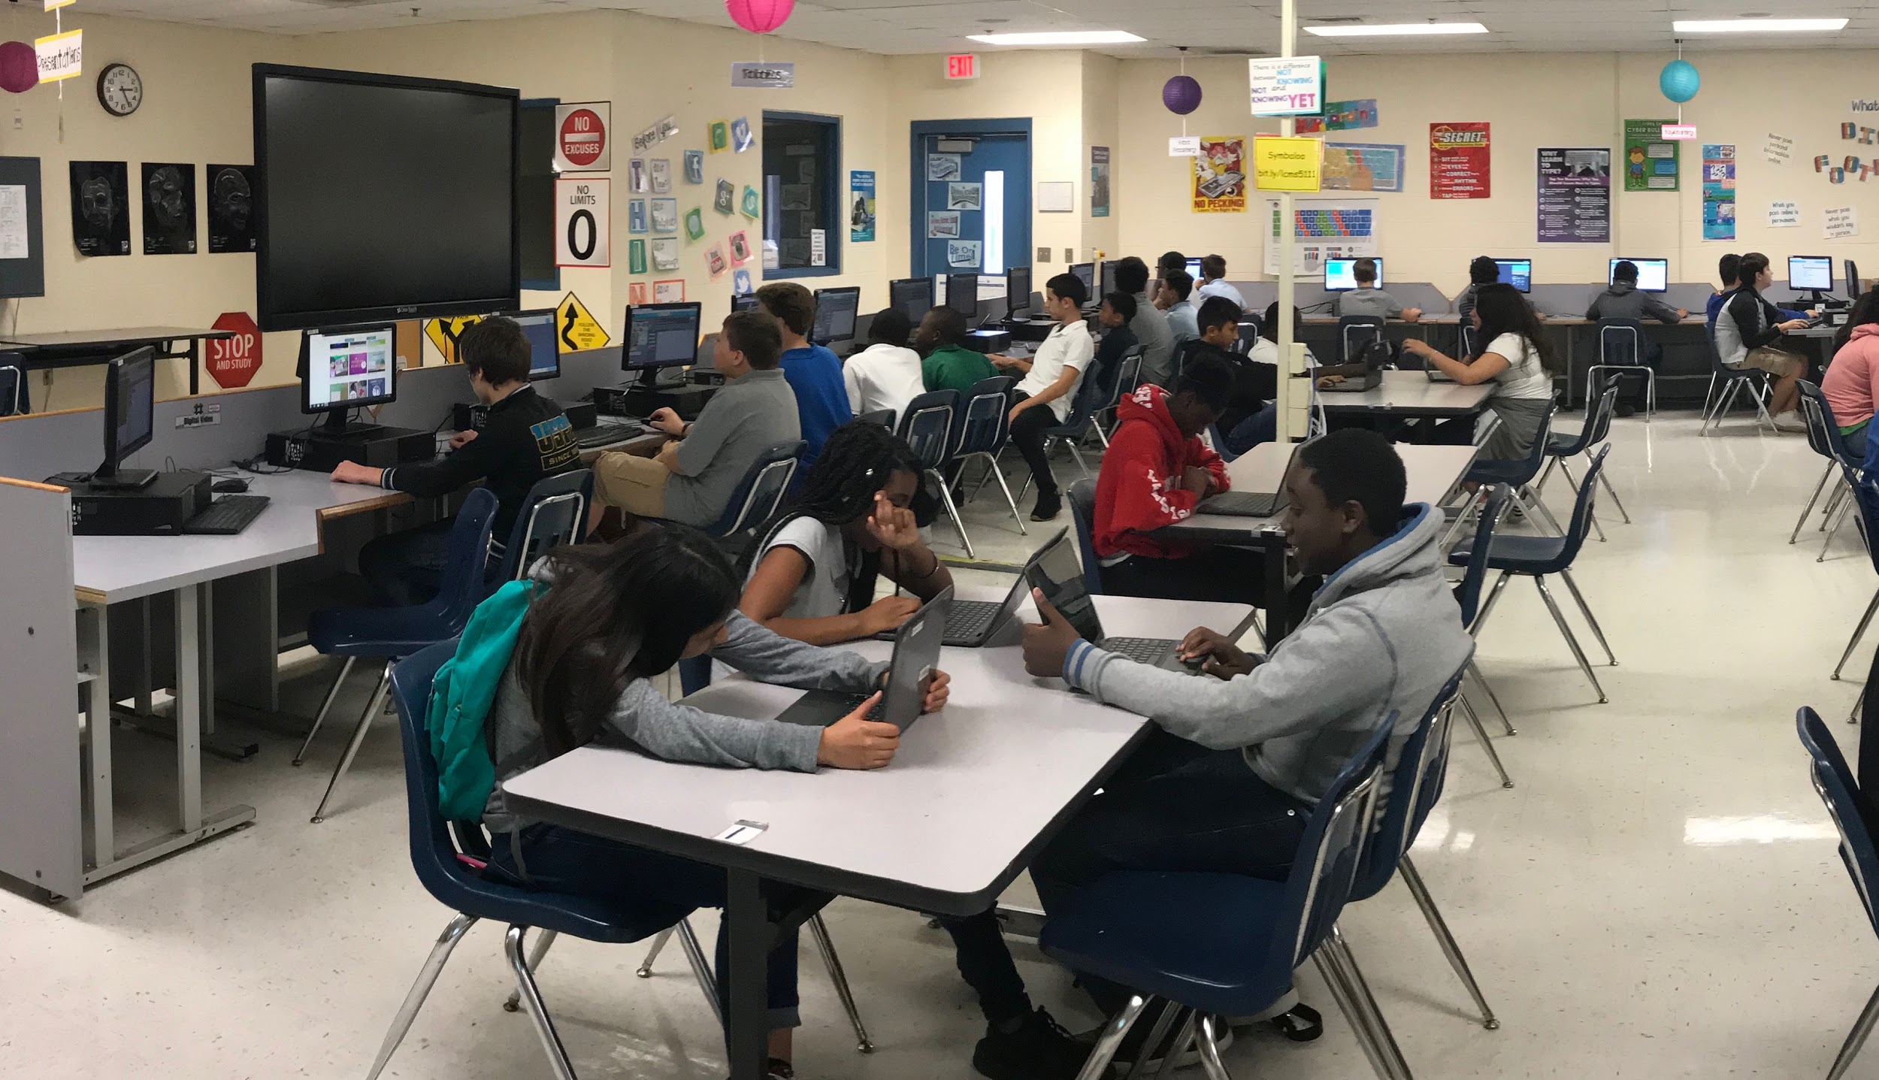
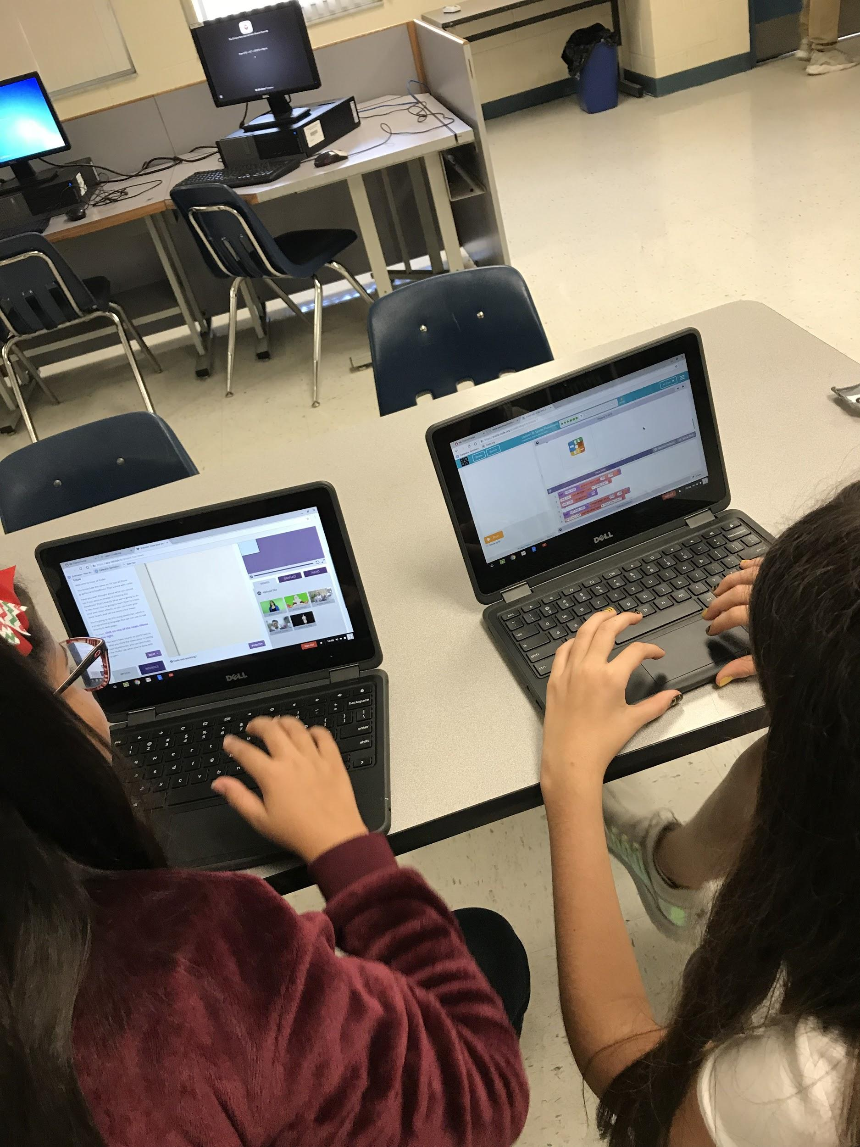
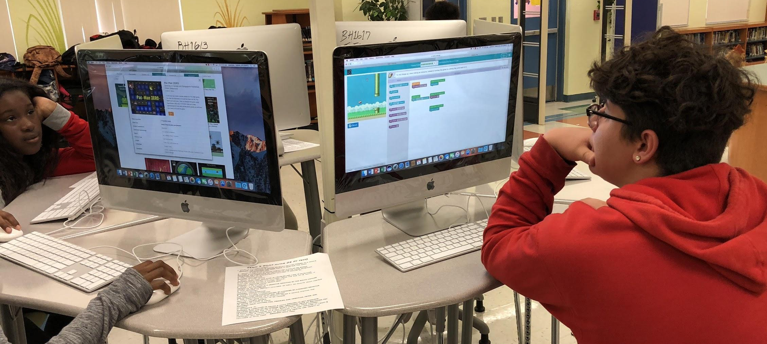
Hour of Code
@TeachCode | #TeachCode | @pbcsdTechConf | #pbcsdTechConf

Slide 10
Other Code Activities
Codesters https://www.codesters.com/?next=/home/classes/#class-44373d
https://vimeo.com/album/4953791/video/253053987
Google CS First https://csfirst.withgoogle.com/en/home
Khan Academy https://www.khanacademy.org/computing
Codecademy https://www.codecademy.com/
Girls Who Code https://girlswhocode.com/
@TeachCode | #TeachCode | @pbcsdTechConf | #pbcsdTechConf

Slide 11
Other Code Activities
@TeachCode | #TeachCode | @pbcsdTechConf | #pbcsdTechConf

