Slide 1

Google Classroom
And Tools

Slide 2
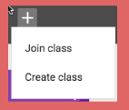
Create a Classroom
www.classroom.google.com
Once opened, plus in right corner
Assign name, then create
Under students: you’ll see the code for students to join your class or invite with email.
Under stream: create announcements, assignments and/or questions
  use other documents, google docs, forms, pictures and quizzes (forms)
About:for a class description and access to class google drive

Slide 3
Students Joining
Log in to email and choose invite from email or
Go to www.classroom.google.com to join a class with code
On class page the students will see announcements and assignments
Work can be completed in google docs or other programs and uploaded using the turn in section in the assignment section

Slide 4

Google Drive
Each google email has 5 gigs of storage in their drive
Each classroom has 5 gigs
  Shared work folder where students can share with each other and teachers can share with students (no limit)
  Google photos where you upload and share photos

Slide 5
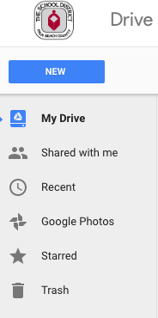
Personal Google Drive
Ever Teacher has google drive
From your email click the boxes area & select google drive
You will see any items you uploaded to the drive and shared with me where the LTM & PLC folders are located

Slide 6
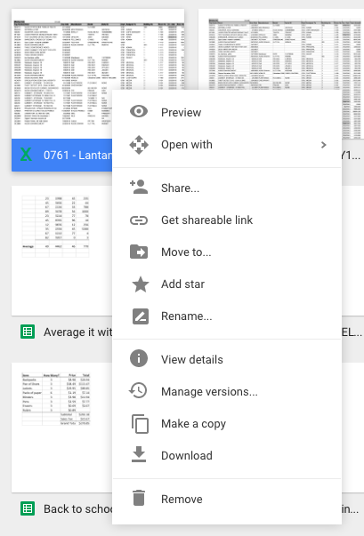
Google Drive Cont.
At any time you may add docs to any folder you have access to
And you may share with others by right clicking the doc
Other tools are available too

Slide 7

Docs
Upload existing documents from computer
Create, edit and share
Live sharing
Very similar to Microsoft word, less font choices

Slide 8

Photos
Upload, edit and share
Another cloud like service to save all photos

Slide 9

Forms
Create surveys with: likert scales, true/false, multiple choice, short answer, paragraph answer, check boxes and drop down menus
Can add videos and pictures to questions
In setting make it a quiz
Grade sent to creator

Slide 10

Sheets
Spreadsheet program
Very similar to Microsoft excel, fewer options
Can make charts, sort and math (formulas)

Slide 11

Slides
Power point
Create multi slide presentations with text, video and photos
Templates available, large amount of design choices, transitions, animations
No sounds

Slide 12

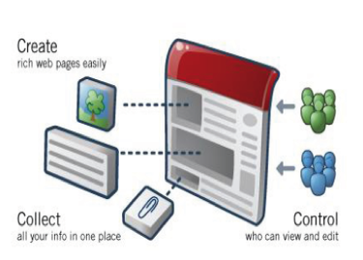
Sites
Web site creator
Simple drag and drop
text

Slide 13

Translate
Many languages included, Creole and Spanish
Input text in any language translate to others

Slide 14

You Tube
Save videos to show to classes
Find videos to include in other applications: docs, forms, slides and sites

Slide 15

News
Updated hourly
All news topics
Read short intro or open entire story, some include videos and photos

Slide 16

Hangouts
New!
students have no access, teachers do
A way to message, call others in google
Multi-way calling

Slide 17

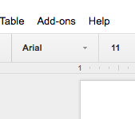
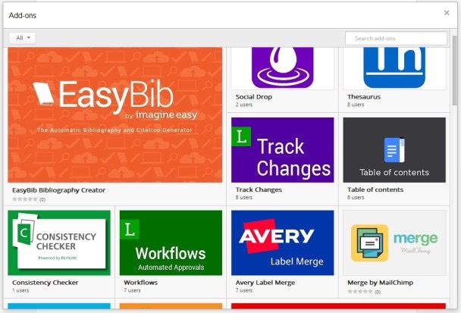
Add-Ons
For everything!
Help In spelling to merging forms to editing tools
Different add-ons for the different apps

