Slide 1
Google Tools
https://gsuite.google.com/learning-center/
Advanced topics

Slide 2
Create a classroom
www.Classroom.google.com
Under stream: create announcements, assignments and/or questions
  use other documents, google docs, forms, pictures and quizzes (forms), slides, sheets, etc…..
About: for a class description and access to class google drive

Slide 3

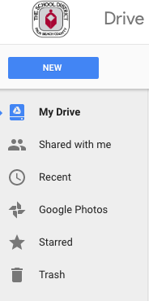
Personal
Google Drive
Shared with me – you should see Lantana teachers, LTM, PLC, PDD (other people share with you)
Folders you share in My Drive
Photos – your photos, you can shared individual or make folders and share

Slide 4

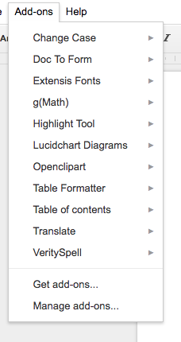
docs
Upload existing documents from computer
Create, edit and share
Live sharing
More add-ons: teacher rubric, gradeproof, sentences diagrams, formula editor, Doc tools, vextab music, proofread

Slide 5

photos
Upload, edit and share
Another cloud like service to save all photos

Slide 6

forms
Create surveys with: likert scales, true/false, multiple choice, short answer, paragraph answer, check boxes and drop down menus
Can add videos and pictures to questions
In settings make it a quiz
Create a sheets with all quiz info
Export as CSV to then import into gradequick
Add-on: Choice eliminator 2, g(math), paper scorer, form recycler

Slide 7

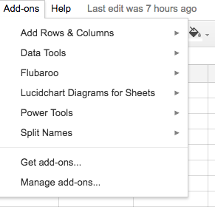
sheets
Spreadsheet program
Very similar to Microsoft excel, fewer options
Can make charts, sort and math (formulas)
Add-ons: save as doc, styles, doctopus, add row/column, lab scheduler, opensolver, form creator,

Slide 8

slides
Power point
Create multi slide presentations with text, video and photos
Templates available, large amount of design choices, transitions, animations
No sounds

Slide 9

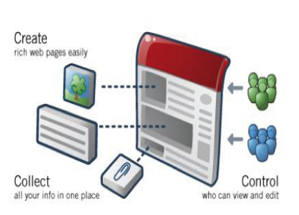
sites
Web site creator
Simple drag and drop
text

Slide 10

Translate
Many languages included, Creole and Spanish
Input text in any language translate to others
Add-ons in docs and sheets

Slide 11

You tube
Save videos to show to classes
Find videos to include in other applications: docs, forms, slides and sites

Slide 12
Google earth
See anything around the earth
View images others uploaded
Create tours to go along with lessons, history, books. Etc…

Slide 13

News
Updated hourly
All news topics
Read short intro or open entire story, some include videos and photos

